Slide 1


Epicycle
A Unified System for Peer to Peer Bike Rental, Sharing, and Advocacy

Slide 2
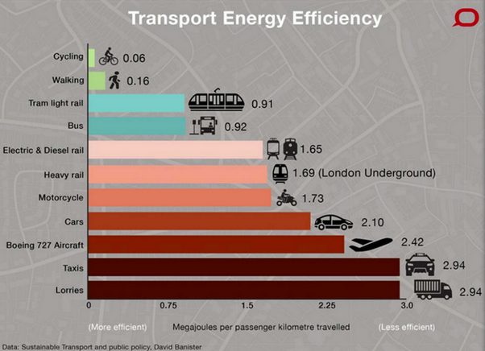

Cycling is an Efficient Solution
Transportation Crisis
“As population growth continues, the pressure on mobility is becoming unsustainable. Transport systems are over-crowded, traffic congestion is at an all-time high (and rising), and this is accompanied by increasing environmental and health concerns. Many remain left behind by the freedoms that transportation has afforded, unable to travel to schools, jobs, hospitals or grocery stores.”
-- HackMobility 2019
So what’s holding back bike sharing?

Slide 3





The Problem with Bicycles
Maintenance Costs
Vandalism
Oversupply by Competition
Parking & Infrastructure
Social Pressures
Bikes break down fast and need to be constantly maintained and repaired
People just like breaking, stealing, and damaging things that aren’t theirs
Fear of Missing Out drives companies to flood too many bikes in not enough space
Cities were designed with cars in mind; changes need to be made
Face it: cycling just isn’t cool

Slide 4


Slide 5




The Solutions of Epicycle
NOT yet another bike share startup
Natural Growth of Scope and Scale
Integration with Car Solutions
Epicycle is a platform to enable bike share and rental, NOT yet another bike share startup
Epicycle leverages existing bikes and bike usage programs to grow usage gradually and naturally
Epicycle intelligently ports tools, resources, and infrastructure used for cars over to bicycles

Slide 6





The Product
Smart Car Integration
Smart Bikes built on Smart Car infrastructure for fast unlock & rental
Instant Communication
Integration with Here to constantly monitor location and availability
Networked Data
Full network integration to intelligently target expansion and growth

Slide 7

DEMO
Epicycle Platform “Kepler” in Action

Slide 8



Business Model
There is an opportunity for success
Fortify
De-Marginalize
Research
Gradual change in cycling culture by gradual and intelligent expansion and education
Making transportation more equitable and available to marginalized communities
Networked Location Data to intelligently grow and target infrastructure efforts

Slide 9


Market Opportunity
$1.6B
$2000
Global bicycle share market 2019
Average annual savings of bicycle vs car commuting

Slide 10
Competition
Our Company
Competitors
Epicycle is NOT yet another bike or scooter share startup, it is a vendor for bike and scooter share startups
Epicycle provides a platform and marketplace to allow anyone to enter the bike rental and sharing market
Epicycle serves bike and scooter transportation companies with valuable data to guide strategy
Regular bike and scooter startups and transportation companies are flooding the market with oversupply
Mass wastage due to overproduction of bicycles and scooters for slow adoption and infrequent usage
Mass cutthroat competition due to FOMO rushing to market

Slide 11
Growth Strategy
How will we scale in the future
Phase 1 – Epicycle Platform “Kepler” 2020
Phase 2 – Epicycle Skeleton “Newton” 2021
Phase 3 – Epicycle Data “Einstein” 2022
Initial establishment with focus on small peer-to-peer sharing
Improving efficiency of sharing and renting through deployment of unified hardware for fast peer-to-peer exchanges
Unified API to allow convenient switching between transportation companies
Deployment of data services to help transportation companies target their growth
Targeted expansion of Epicycle services in parallel with clients and partners into new markets

Slide 12
Timeline
Our two-year action plan
Epicycle Platform
Epicycle Lock MVP
Epicycle Data v1
Feb, 2020
Oct, 2020
Nov, 2021
JAN
FEB
MAR
APR
MAY
JUN
JUL
AUG
SEP
OCT
NOV
DEC
JAN
FEB
MAR
APR
MAY
JUN
JUL
AUG
SEP
OCT
NOV
DEC
2020
2021
Epicycle Platform v2
Epicycle Platform v3
Epicycle Skeleton Lock
Jun, 2020
Jan, 2021
Jul, 2021

Slide 13





Thank You
Kalle Persson
+1 23 987 6554
kalle@tryepicycle.com
www.tryepicycle.com

